Slide 1

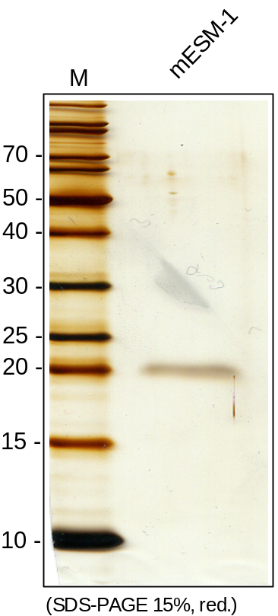
ReliaTech GmbH
Recombinat mouse Endocan/ESM-1
(Cat# M30-062)
Fig. 1: SDS-PAGE analysis of recombinant mouse Endocan/ESM-1 derived from insect cells. Sample was loaded in 15% SDS-polyacrylamide gel under reducing conditions and stained with Silverstain.
http://www.reliatech.de / orders@reliatech.de

